Slide 1
Volume vs Capacity

Slide 2
Volume – the amount of space a solid occupies
Capacity – the amount a container can hold
Notes:
https://www.123rf.com/photo_3507243_vector-illustration-of-cardboard-box-closed-and-open.html

Slide 3
Volume
Measured in cubic metre (m³), cubic centimetre (cm³) etc.
Capacity
Measured in litres (L), millilitres (mL) etc.

Slide 4
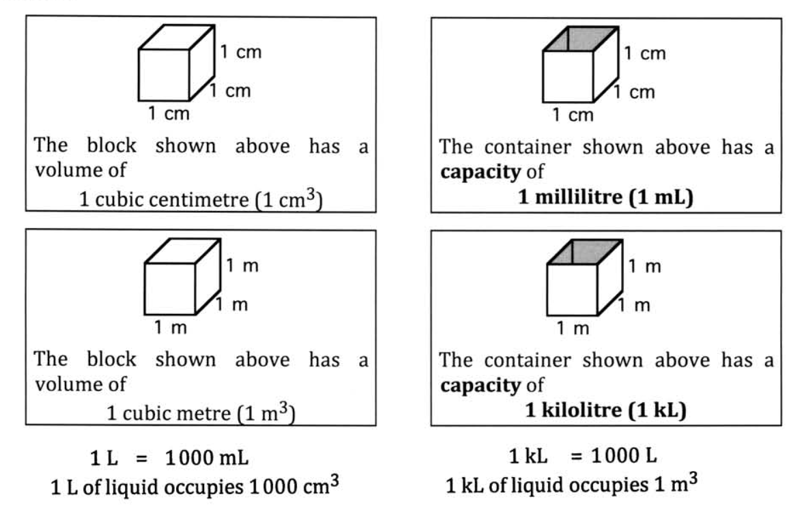
Conversion

